Slide 1


Slide 2

Noughts and crosses

Slide 3


now
homework
prefer
digital learning
good at
school
in the park
today
bat at

Slide 4
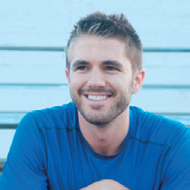
Who is he?
What does he do?
What is he doing now?

Slide 5

UNIT 4
learning world
Lesson 5: language focus

Slide 6
Look at the sentences. What are the he / she and they forms of each question and answer?
1) Are you learning English? Yes, I am.
Is he / she learning English? - Yes, he / she is.
Are they learning English? Yes, they are.
2) What are you doing now? I’m watching TV.
What is he / she doing now? He’s / She’s watching TV.
What are they doing now? They’re watching TV.
3) Are you learning the same language? No, we aren’t.
Is he / she learning the same language? No, he / she isn’t.
Are they learning the same language? No, they aren’t.

Slide 7


Slide 8
PRESENT CONTINUOUS TENSE (cont)
QUESTIONS
YES-NO QUESTIONS
WH-QUESTIONS

Slide 9
☞ YES-NO QUESTIONS
Am/ Is / Are + S + V_{ing} + O ?
Short answer:
Yes, S + am/ is / are.
No, S + am/ is /are + NOT.
Ex: Are you doing your homework?
Yes, I am. / No, I’m not.

Slide 10
☞ WH-QUESTIONS
Wh-question word + am / is / are + S + V_{ing} + O?
Answer:
S + am / is / are + V_{ing} + O
Ex: What are you doing now?
➔ I’m doing my homework.

Slide 11

Pair-work

Slide 12
Ask and answer questions with words from the columns and the verbs in the box. Use the present continuous.
do work study sit wear look at
What Where Why Who | is are | the teacher your friend you your parents | …..?

Slide 13

Where are you going?
I’m going to the supermarket.

Slide 14
Complete the table with sentences 3 – 6. Which time expressions do we use with a) the present simple, and b) the present continuous?
1) We sometimes do projects. 2) We’re doing a project today. 3) I usually check new words. 4) I’m checking a new word at the moment. 5) They always wear uniforms. 6) They’re wearing their uniforms now.

Slide 15
Present simple | Present continuous
1) We sometimes do projects.
2) We’re doing a project today.
4) I’m checking a new word at the moment.
3) I usually check new words.
5) They always wear uniforms.
6) They’re wearing their uniforms now.

Slide 16
 | Present simple | Present continuous
USE
TIME EXPRESSIONS
Routines or repeated actions
Actions happening now
sometimes, usually, always (often, never, every day)
today, at the moment, now (right now)

Slide 17

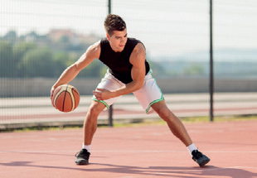
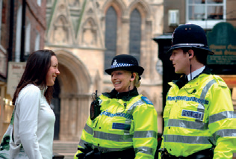
WHO ARE THEY?
Charlotte
Pat
Melanie

Slide 18
Look at the photos and complete the sentences. Use the present simple or the present continuous.
Charlotte is a music student. She (1) ____________ (practise) every day, but at the moment she (2) ______________ (relax).
practises
is relaxing

Slide 19
Pat is a footballer. He (3) _______ (play) football five days a week, but today he (4) ____________ (play) basketball.
plays
is playing

Slide 20
is chatting
Melanie (5) ____________ (chat) in Spanish with a tourist now, but she usually (6) _______ (speak) English
speaks

Slide 21

Lottery Winner!

Slide 22

Imagine that one of you is a lottery winner. Ask and answer questions about now and usually. Use the present simple and the present continuous forms of the verbs in the box.

Slide 23
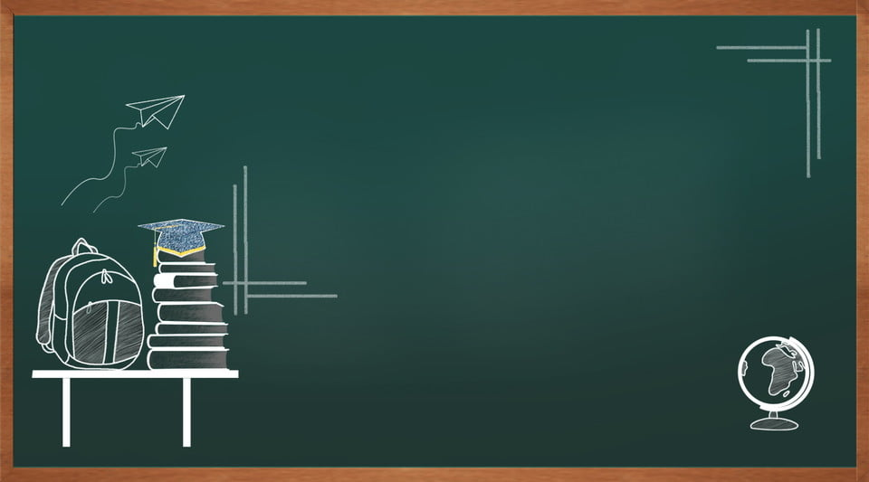
Homework
- Learn by heart the new structure.
- Prepare for next lesson – SPEAKING

Slide 24


